Slide 1
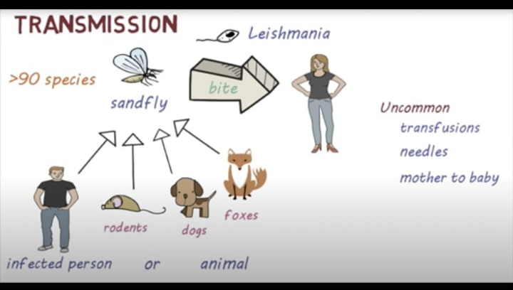
INTRODUCTION
Leishmaniasis is a parasitic disease.
Leishmaniasis is caused by infection with Leishmania parasites.
Parasites were spread through phlebotomine sand flies.

Slide 2
Who will be affected by Leishmaniasis?
> The one who live in rural areas with inadequate sanitation.
People with HIV and other conditions that weaken their immune
system are more likely become prey for Leishmania.

Slide 3
Leishmaniasis is currently considered the third most important vector-borne parasitic disease after malaria and lymphatic filariasis.
Types of Leishmaniasis :
Visceral Leishmaniasis
Cutaneous
Mucocutaneous

Slide 4
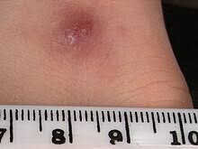
1) Cutaneous Leishmaniasis :
It is a Infection in our skin .
We get a bump that turn into large ulcer.
2) Mucosal Leishmaniasis :
Complication of cutaneous leishmaniasis.
Ulcers develops in nose , mouth .

Slide 5
Visceral Leishmaniasis (Kala-azar) :
1) Serious form of the disease .
2) Affects internal organs
Symptoms : Fever
Chills
Weight loss
Fatigue

Slide 6
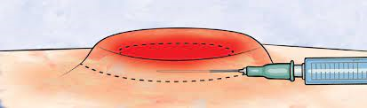
Diagnosis
Needle biopsy
Skin biopsy

Slide 7
Prevention
Avoid sand fly bites
Cover exposed skin with clothing
Kill sand flies by spraying insecticides

Slide 8
Bio informatic analysis:
Retrieve Dna Sequence
Preprocessing
Genome Sequence
Species identification
Visualization

Slide 9
Machine learning techniques :
KNN (K Nearest Neighbours)
SVM (Support Vector Machines)
Both are popular supervised machine learning algorithms used for classification and regression

Slide 10
K-Nearest-Neighbour
Classifies a data point by comparing it to K nearest neighbours in training dataset
To classify new point we calculate distance between new point and existing(Training point).
Will select K nearest points , data point will be updated to the majority number .

Slide 11
Support vector machines
We will find optimal hyperplane to separate data points of different classes.
Tries to maximize the margin between data points.
Once hyperplane established , SVM can classify new data point by assigning to either classes , based on which side hyperplane they fall.
Effective for large dimension.

